Slide 1
A few months ago I started a Data Analytics course with Cambridge Spark and I wish I had done it earlier because I enjoyed it immensely and looked forward to every session.
This course gave me the opportunity to:
analyse large datasets and perform data manipulation using Pandas and Numpy,
carry out data cleaning, pre-processing for accuracy and completeness
implement statistical analysis using Python to identify trends and patterns
optimise SQL queries to improve data retrieval times
create data visualisations using Matplotlib, Seaborn and Power BI
Overall, I have improved my technical and analytical skills. Now I look forward to learning new things and progressing in this field.

Slide 2

Life Expectancy at birth
&
Healthy Life Expectancy at birth
by Lidia Pascu

Slide 3

I have based my research on data from World Health Organization(WHO).
I investigated and found patterns and trends countries in various locations across the World.
Analysing 2904 rows of data, I saw patterns of Life expectancy and Healthy Life expectancy at birth (HALE) throughout the whole regions.
"Life expectancy" refers to the number of years a person can expect to live.
It is an important way of assessing the health of a population and is used to inform health policy and initiatives that impact everyday life.
"Life expectancy at birth" is the average number of years that a newborn could expect to live, while "Healthy life expectancy (HALE) at birth" is the average number of years that a person could expect to live in "full health" from birth. This measurement takes into account years lived in less than full health due to disease and/or injury.

Slide 4
A visual analysis of two datasets: Life Expectancy
& Healthy Life Expectancy at birth between 2000-2021
Project overview:
Merging the two dataframes for a better visualisation and comparison
Gender grouped by Life expectancy (at birth) and Healthy life expectancy (at birth) mean and each category individually
Global analysis by Life expectancy (at birth) and Healthy life expectancy (at birth)
WHO regions by Life expectancy (at birth) and Healthy life expectancy (at birth)
Analysing and comparing WHO regions - Africa and Europe
Top 10 Countries Life expectancy (at birth) years 2000 & 2021
World Bank Income Group regions analysis
National liberation movement and organized, unincorporated territories
Poor health according to Life expectancy (at birth) and Healthy life expectancy at birth
Conclusion

Slide 5
Average life expectancy and healthy life expectancy are both important headline measures of the health status of the population.
The healthy life expectancy measure adds a ‘quality of life’ dimension to estimates of life expectancy by dividing it into time spent in different states of health.
Data cleansing steps:
Original Datasets: 13 columns | 2904 rows each
After Cleansing and Manipulating: 7/8 columns | 2904 rows each
Checked for null values and duplicates
Dropped columns for easier handling of data and clearer analysis
Renamed the columns for a better visualisation and understanding
Change the format of two columns for a better view

Slide 6
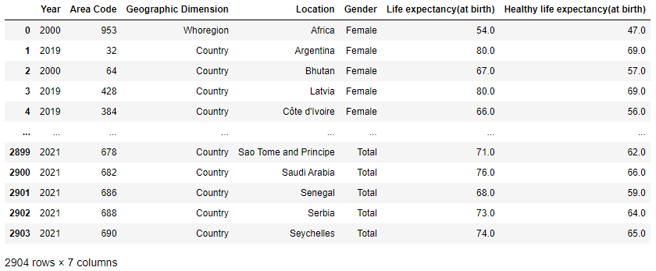
Merging the datasets:
Life Expectancy &
Healthy Life Expectancy at birth

Slide 7
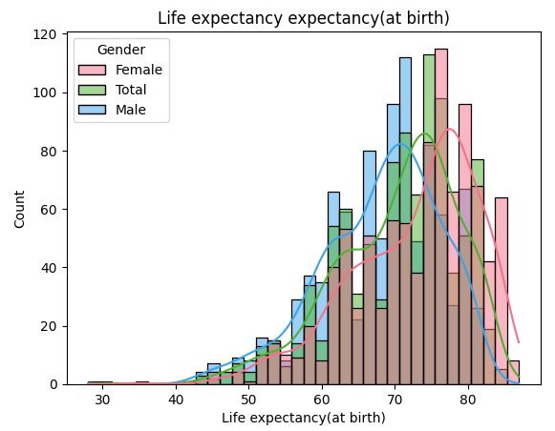
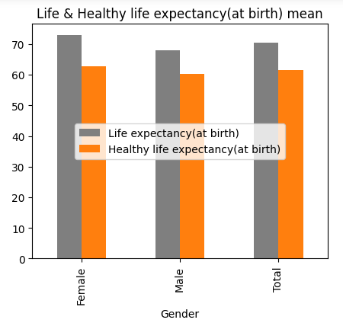
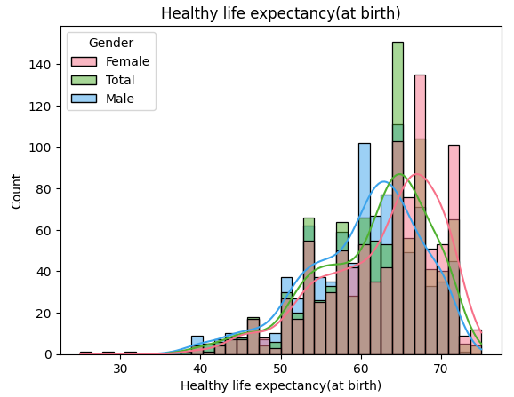
2. Gender grouped by Life expectancy (at birth) & Healthy life expectancy (at birth) mean and presented individually
From this bar and hist plots we can clearly deduce that the average Life and Healthy life expectancy (at birth) for women is significantly higher than that of men.

Slide 8
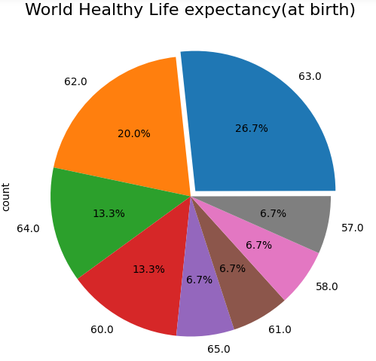
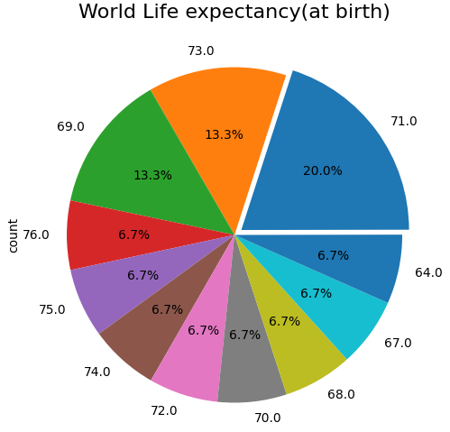
3. Global analysis by Life expectancy
(at birth) &
Healthy life expectancy (at birth)
Worldwide, Life expectancy (at birth) is predominant at 71 years, followed by 73 and 69 years.
Compared to Life expectancy (at birth) , Healthy life expectancy (at birth) is much lower at 63 years, followed by 62 years.

Slide 9
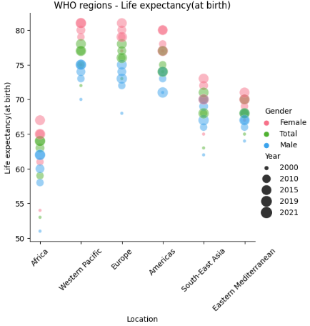
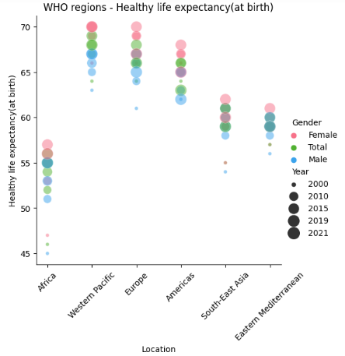
4. WHO Regions by Life expectancy (at birth) and Healthy life expectancy (at birth)
Having a first look at the relational plot for WHO regions we can determine that women have a higher "Life expectancy" and " Healthy life expectancy(at birth)" than men throughout all regions.
Healthy life expectancy has remained much lower than life expectancy. Although females live longer than males, there is little difference in the level of healthy life expectancy.

Slide 10
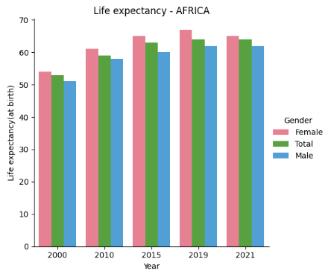
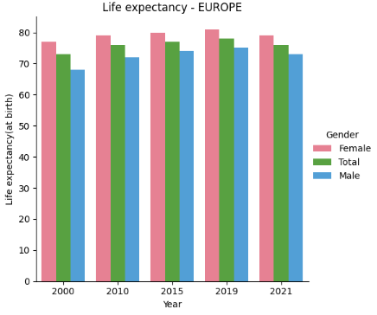
5.1 Analysing and comparing WHO regions - AFRICA and EUROPE
Life expectancy (at birth) between 2000 - 2021
In summary, while life expectancy has improved worldwide, disparities exist between regions.
However, it’s essential to note that the average life expectancy in Africa is just under 61 years, indicating that health challenges impact both longevity and quality of life in the region.
Europe tends to have a higher average life expectancy of almost 76 years.

Slide 11
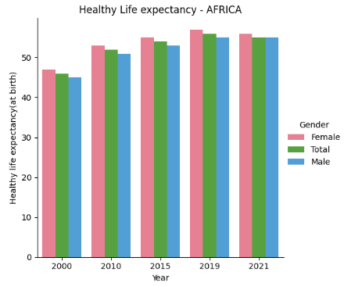
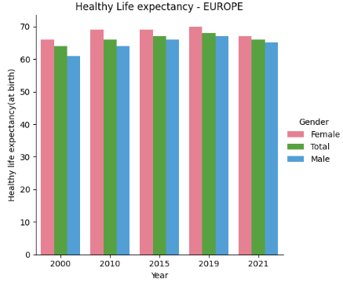
5.2 Analysing and comparing WHO regions - AFRICA and EUROPE
Healthy life expectancy (at birth) between 2000 - 2021
The average healthy life expectancy for a person in Africa was about 53 years, compared to 66 years in Europe between 2000 and 2021.

Slide 12
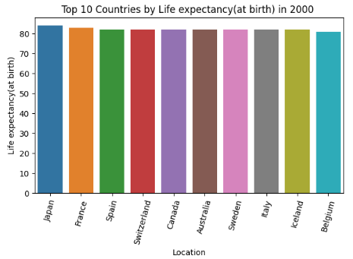
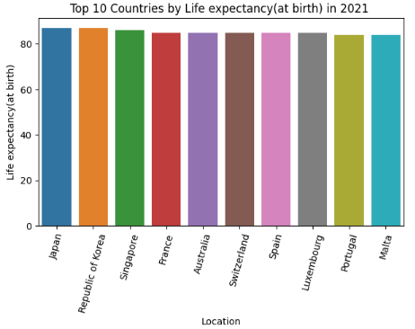
6. Top 10 Countries
- Life expectancy -
2000 & 2021
If we examine the differences between the two bar charts for the years 2000/2021, we see that Japan is in the top place in both years.
France drops from second to fourth place, followed by Spain, which drops significantly to seventh place, Switzerland from fourth to sixth place and Australia moves up one place from sixth to fifth place.
Some other countries have lost their top 10 positions in 2021, while others have taken their place.

Slide 13
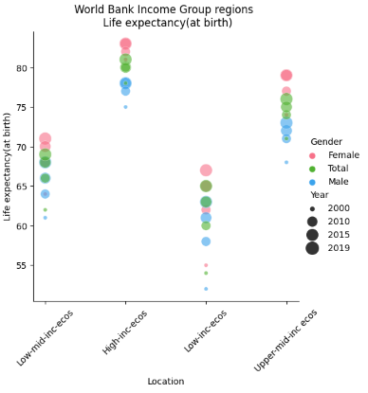
7. World Bank Income Group regions analysis
7.1 Life expectancy at birth
Low-income countries:
67 years (females), 65 years (both sexes) , 63 years (males).
Lower-middle-income countries:
71 years (females), 69 years (both sexes), 68 years (males).
Upper-middle-income countries:
79 years (females), 76 years (both sexes), 73 years (males).
High-income countries:
83 years (females), 81 years (both sexes), 78 years (males).

Slide 14
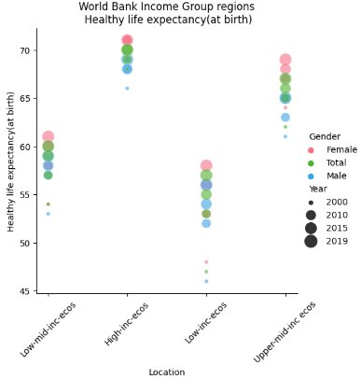
7. World Bank Income Group regions analysis​
7.2 Healthy life expectancy at birth
Low-income countries: ​​
67 years (females), 65 years (both sexes) , 63 years (males).​​
Lower-middle-income countries: ​​
71 years (females), 69 years (both sexes), 68 years (males).​​
Upper-middle-income countries: ​​
79 years (females), 76 years (both sexes), 73 years (males).​​
High-income countries:​​
83 years (females), 81 years (both sexes), 78 years (males).

Slide 15
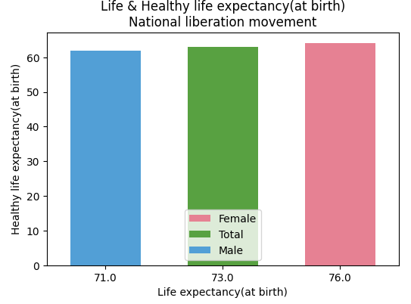
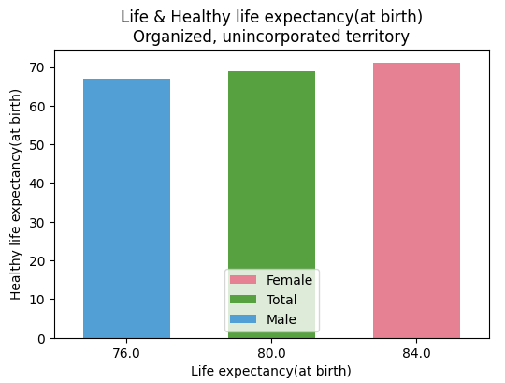
8. National liberation movement and organized, unincorporated territories
Life expectancy at birth & Healthy life expectancy at birth

Slide 16
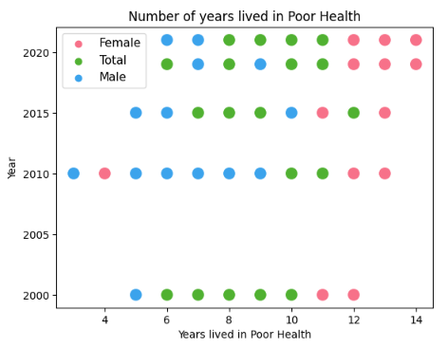
9. Poor health according to Life expectancy and Healthy life expectancy at birth
The average number of years lived in poor health is the average life expectancy minus the average number of years lived in good health (healthy life expectancy).
An increase in the average number of years lived in poor health is often referred to as ‘expansion of morbidity’, whereas a reduction is referred to as ‘compression of morbidity’

Slide 17
Conclusion
In conclusion, while both metrics are improving, the gap between life expectancy and healthy life expectancy at birth highlights the ongoing need to focus not just on prolonging life but also on enhancing the quality of health throughout those years.
Women live longer than men, even though many of the recognised social determinants of health are worse for women than men.
No existing explanations account fully for these differences in life expectancy, although they do highlight the complexity and interaction of biological, social and health service factors.
Life expectancy at birth is widely recognized as a summary measure of mortality that allows the extent and trend of health inequalities to be compared within and across societies.
Since 2000, in all countries in the world, women have lived longer than men, but paradoxically report more illness than men.
Depression and mental health issues, which are slightly higher among women, are also one explanation as to why women live more years in ill-health than men.

